Slide 1
18ECO107T-Fiber Optics and Optoelectronics
(Session 4-6)
Prepared by
Dr.Christeena Joseph,Associate Professor/ECE
SRMIST,Ramapuram

Slide 3
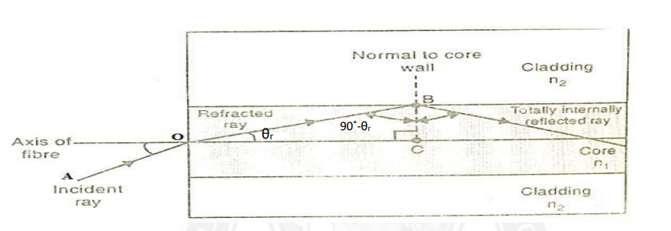
Acceptance Angle
Acceptance angle is the maximum angle with the axis of the Optical Fiber at which the light can enter into the optical fiber in order to be propagated through it.Fig shows the propagation of light in a fiber.

Slide 4
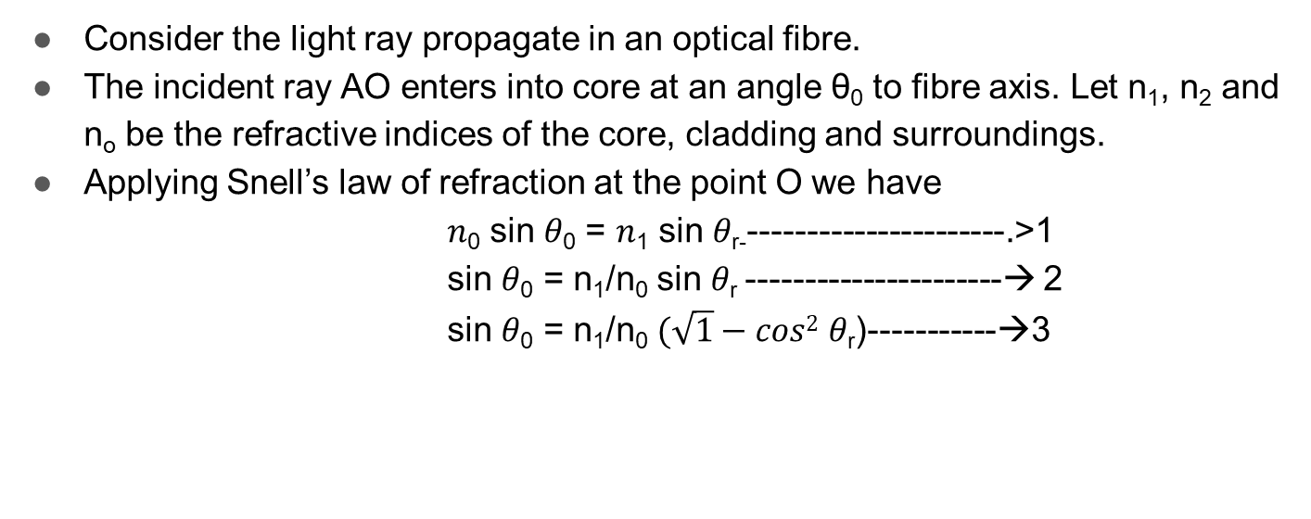

Slide 5
At the point B on the interface of core and cladding,
Angle of incidence 𝜃_{𝑐} = 90 − 𝜃_{r}
Applying Snell’s law of refraction at the point B we have
𝑛₁ sin(90˚ − 𝜃_{𝑟}) = 𝑛₂ sin 90˚-----------------🡪4
𝑛₁ cos 𝜃_{𝑟} = 𝑛₂---------------------🡪5
cos 𝜃_{𝑟} = n₂ / n₁-----------------🡪6
Substituting equation (6) in equation (3) we have
sin 𝜃₀ = n₁ / n₀ (√1 − 𝑛₂ ² / 𝑛₁ ²)------🡪7
sin 𝜃₀ = n₁ / n₀ (√ (𝑛₁ ² − 𝑛₂ ²) / 𝑛₁ ²)------🡪8
sin 𝜃₀ = (n₁ / 𝑛₁ n₀) (√ (𝑛₁ ² − 𝑛₂ ²))------🡪9
sin 𝜃₀ =(√ (𝑛₁ ² − 𝑛₂ ²)/ n₀ ------🡪10

Slide 6

The medium surrounding the fibre is air, then n_{o} = 1 then eq 10 becomes
sin 𝜃₀ =(√ (𝑛₁ ² − 𝑛₂ ²) ------🡪11
Acceptance angle 𝜃₀ = sin ⁻¹(√ (𝑛₁ ² − 𝑛₂ ²) ------🡪12
Numerical Aperature NA= sin 𝜃₀ -------------------🡪13
Acceptance angle 𝐬𝐢𝐧 𝜽_{o} < 𝑵𝑨
The maximum angle at or below which a ray of light can enter through one end of the fibre still be total internal reflection is called as acceptance angle. The cone is referred as acceptance cone.
Numerical Aperture (NA) Sine of the acceptance angle of the fibre is known as numerical aperture. It denotes the light gathering capability of the optical fibre
Numerical Aperature NA= sin 𝜃₀
Fractional Index Change (Δ) 𝑁𝐴 = sin 𝜃₀ It is the ratio of refractive index difference in core and cladding to the refractive index of core.

Slide 7
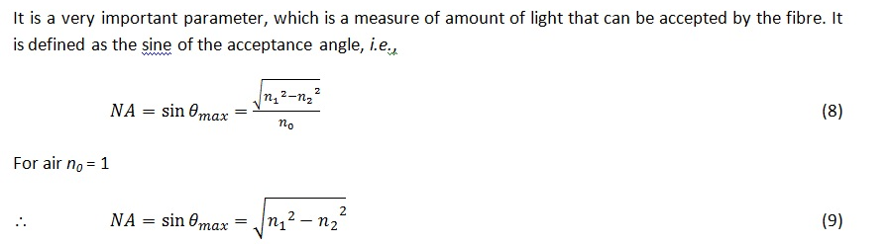
Numerical Aperture
Numerical aperture in case of optical fiber communication can be defined as- "The light gathering (collecting) capacity of an optical fibre".
The numerical aperture provides important relationship between acceptance angle and the refractive index of the core and cladding

Slide 8
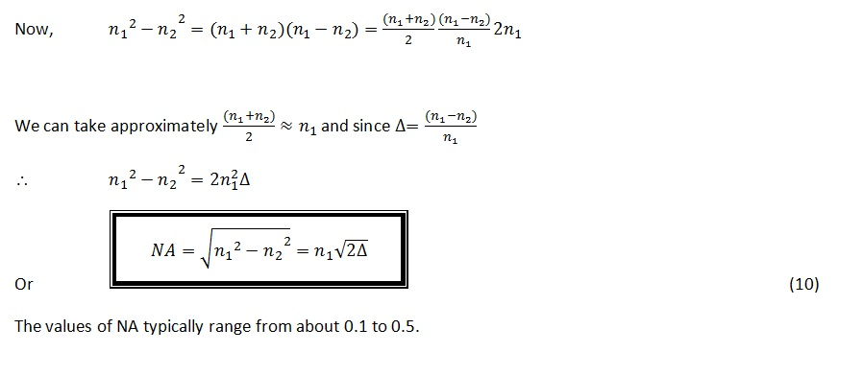

Slide 9
Problem 1:
The Refractive Indices of core and cladding are 1.50 and 1.48 respectively in an Optical Fiber. Find the Numerical Aperture and Acceptance Angle

Slide 10
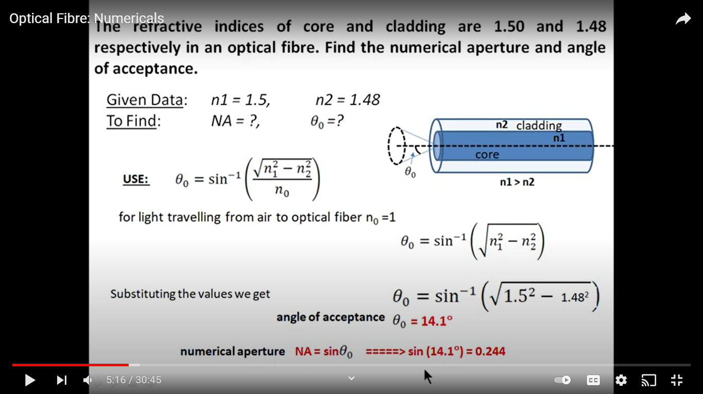
Problem 1:
The Refractive Indices of core and cladding are 1.50 and 1.48 respectively in an Optical Fiber.Find the Numerical Aperture and Acceptance Angle

Slide 11
Problem 2
An Optical Fiber has a core material with refractive index 1.55 and its cladding material has a refractive index of 1.50.The Light is launched into it in air. Calculate its numerical aperture, the acceptance angle and also fractional index change

Slide 12
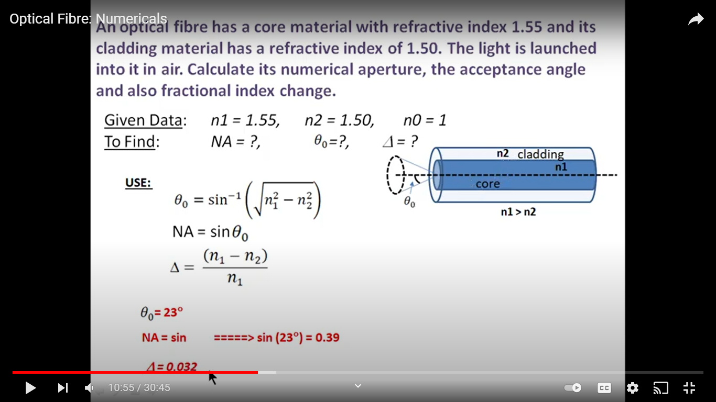
2.An Optical Fiber has a core material with refractive index 1.55 and its cladding material has a refractive index of 1.50.The Light is launched into it in air.Calculate its numerical aperture,the acceptance angle and also fractional index change

Slide 13
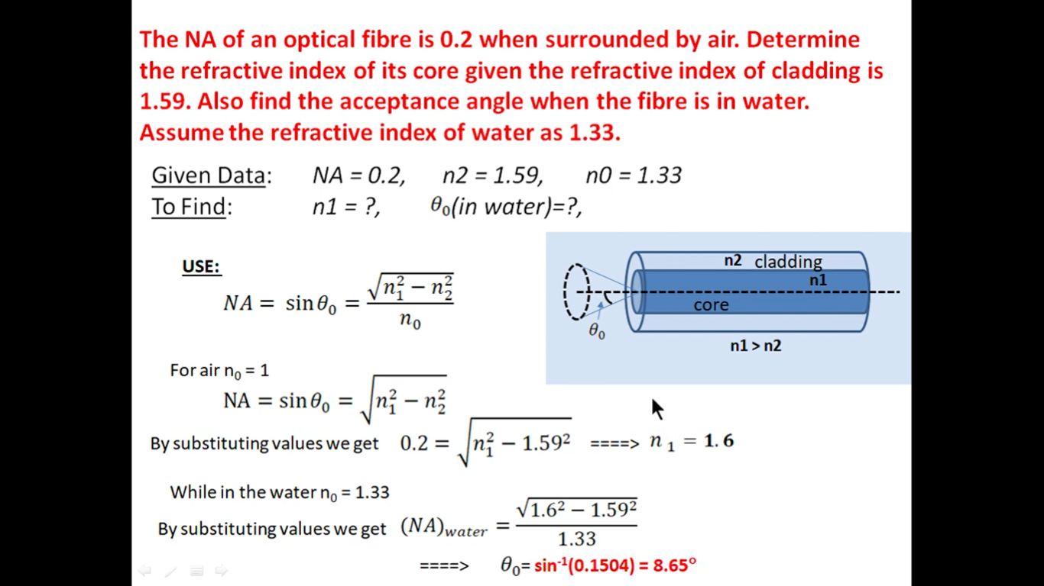

Slide 14
Ray Optics
Optics is the study of light and its interaction with matter.
Light is visible electromagnetic radiation, which transports energy and momentum (linear and angular) from source to detector.
Photonics includes the generation, transmission, modulation,amplification,frequency conversion and detection of light.
Ray optics is the simplest theory of light. Rays travel in optical media according to a set of geometrical rules; hence ray optics is also called geometrical optics.
Ray optics is an approximate theory, but describes accurately a variety of phenomena.
Ray optics is concerned with the locations and directions of light rays, which carry photons and light energy (They also carry momentum, but the direction of the momentum may be different from the ray direction).
It is useful in describing image formation, the guiding of light, and energy transport.

Slide 15
Postulates of Ray Optics
1. Light travels in the form of rays .Rays are emitted by light sources, and can be observed by light detectors.
2. An optical medium (through which rays propagate) is characterized by a real scalar quantity n ≥ 1, called the refractive index. The speed of light in vacuum is c = 3 × 10⁸m/s.The speed of light in a medium is v = c/n; this is the definition of the refractive index. The time taken by light to cover a distance d is t = nd/c; it is proportional to nd, which is called the optical path length.

Slide 16
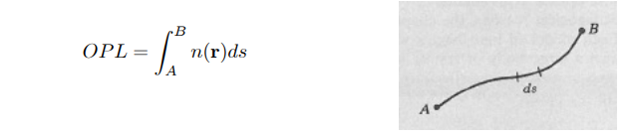
Postulates of Ray Optics
3. In an inhomogeneous medium, the refractive index n(r) varies with
position; hence the optical path length OPL between two points A and B is
where ds is an element of length along the path. The time t taken by light to
go from A to B is t = OPL/c.

Slide 17
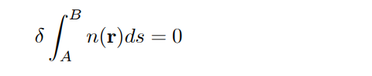
Postulates of Ray Optics
4.Light rays between the points A and B follow a path such that the time of travel, relative to neighboring paths, is an extremum (minimum). This means that the variation in the travel time, or, equivalently,in the optical path lenght, is zero. That is,
Usually, the extremum is a minimum; then light rays travel along the path of least time. If there are many paths with the minimum time, then light rays travel along all of these simultaneously.

Slide 18
Types of Rays
Rays that Interact with surfaces
An incident ray is a ray of light that strikes a surface. The angle between this ray and the perpendicular or normal to the surface is the angle of incidence
The reflected ray corresponding to a given incident ray, is the ray that represents the light reflected by the surface. The angle between the surface normal and the reflected ray is known as the angle of reflection. The Law of Reflection says that for a specular (non-scattering) surface, the angle of reflection is always equal to the angle of incidence.

Slide 19
Types of rays
The refracted ray or transmitted ray corresponding to a given incident ray represents the light that is transmitted through the surface. The angle between this ray and the normal is known as the angle of refraction, and it is given by Snell's Law. Conservation of energy requires that the power in the incident ray must equal the sum of the power in the refracted ray, the power in the reflected ray, and any power absorbed at the surface
If the material is birefringent, the refracted ray may split into ordinary and extraordinary rays, which experience different indexes of refraction when passing through the birefringent material.

Slide 20
Types of rays
Meridional rays are rays that pass through the axis of the optical fiber. Meridional rays are used to illustrate the basic transmission properties of optical fibers.
The second type is called skew rays. Skew rays are rays that travel through an optical fiber without passing through its axis.
Meridional rays can be classified as bound or unbound rays. Bound rays remain in the core and propagate along the axis of the fiber.
Bound rays propagate through the fiber by total internal reflection. Unbound rays are refracted out of the fiber core.
Figure shows a possible path taken by bound and unbound rays in a step-index fiber. The core of the step-index fiber has an index of refraction n1.
The cladding of a step-index has an index of refraction n2 that is lower than n1.
Figure assumes the core-cladding interface is perfect.
However, imperfections at the core-cladding interface will cause part of the bound rays to be refracted out of the core into the cladding.
The light rays refracted into the cladding will eventually escape from the fiber. In general, meridional rays follow the laws of reflection and refraction.

Slide 21
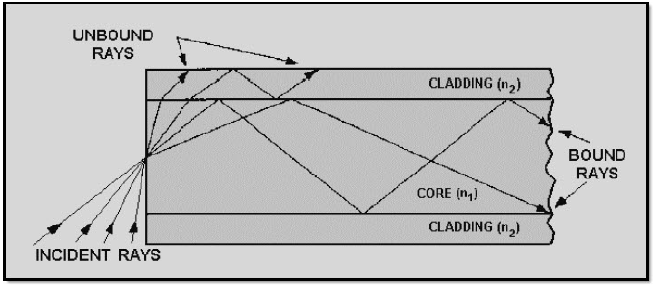

Slide 22
Skew Rays
Skew rays are rays that travel through an optical fiber without passing through its axis.
Skew rays are those rays which follow helical path but they are not confined to a single plane. Skew rays are not confined to a particular plane so they cannot be tracked easily.
Skew rays propagate without passing through the center axis of the fiber. The acceptance angle for skew rays is larger than the acceptance angle of meridional rays.
Skew rays are often used in the calculation of light acceptance in an optical fiber. The addition of skew rays increases the amount of light capacity of a fiber.
The addition of skew rays also increases the amount of loss in a fiber. Skew rays tend to propagate near the edge of the fiber core. A large portion of the number of skew rays that are trapped in the fiber core are considered to be leaky rays.

Slide 23
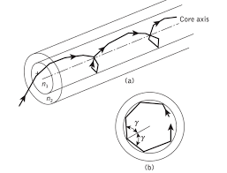
Skew rays

Slide 24
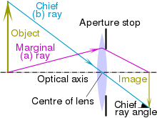
Types of rays
Optical systems
The marginal ray (sometimes known as an a ray or a marginal axial ray) in an optical system is the meridional ray that starts at the point where the object crosses the optical axis, and touches the edge of the aperture stop of the system. Marginal rays are the rays which passes through the maximum aperture of the spherical mirror. This means that they have a Max angle with the principal axis.

Slide 25
Types of rays
The principal ray or chief ray (sometimes known as the b ray) in an optical system is the meridional ray that starts at the edge of the object, and passes through the center of the aperture stop
Sagittal ray or transverse ray
Paraxial ray
Parabasal ray

